Slide 1
BHASHA BRIDGE
PIP4004 University Project
Review-2
Batch Number: CSE-G02
Under the Supervision of,
Ms. Akkamahadevi
Assistant Professor
School of Computer Science & Engineering
Presidency University
SL.No | Name | Roll Number
1. | Satyam Manu Pathak | 20211CSE0512
2. | Ayan Sharma | 20211CSE0523
3. | Jaideep Singh Dudi | 20211CSE0502
Name of the Program: CSE
Name of the HoD: Dr. Asif Mohammed H.B
Name of the Program Project Coordinator: Mr. Amarnath J.L & Dr. Jayanthi. K.
Name of the School Project Coordinators: Dr. Sampath A K / Dr. Abdul Khadar A / Mr. Md Ziaur Rahman

Slide 2
Introduction
We aim to build a software for translating resource material and other texts from English to other local Indian Languages. According to the Census of India of 2001, India has 122 major languages and 1599 other languages are spoken by the 1.38 billion population of India.
According to the Eighth Schedule of the Constitution, twenty-two (22) of them are considered as official languages; viz. Assamese, Bengali, Gujarati, Hindi, Kannada, Kashmiri, Konkani, Malayalam, Manipuri, Marathi, Nepali, Oriya, Punjabi, Sanskrit, Sindhi, Tamil, Telugu, Urdu, Bodo, Santhali, Maithili and Dogri.
Translation services are essential for various sectors. As, most people only know one or two languages, translation services assist them in obtaining necessary information in their own tongue by eliminating the language barrier.
This solution will be user-friendly, easy to use and understand, can work with multiple dialects, and handle linguistic nuances such as grammar, sentence structure, and cultural context. The software will assist in translation of these texts created in multiple forms: word document, pdf document, text in images etc. Our focus is to develop a model with a high accuracy. We also wish to implement text to speech function in our project.

Slide 3
Literature Review
PAPER REFERRED | ADVANTAGES | DISADVANTAGES
Bangla Natural Language Processing: A Comprehensive analysis of Classical, Machine Learning, and Deep Learning-Based methods. IEEE Access, 10, 38999–39044. https://doi.org/10.1109/access.2022.3165563 | The paper provides an extensive review of Bangla NLP, covering classical, machine learning, and deep learning-based methods, making it a valuable resource for researchers and practitioners. | While the paper covers many techniques, it may lack detailed practical implementations or real-world case studies that demonstrate the effectiveness of these methods in applied scenarios.
Low-Resource Neural Machine Translation: A Systematic Literature review. IEEE Access, 11, 131775–131813. https://doi.org/10.1109/access.2023.3336019 | The paper systematically reviews low-resource neural machine translation (NMT) techniques, providing a structured and detailed overview of existing challenges, methods, and advancements. | The paper may focus primarily on widely used benchmark datasets, potentially overlooking real-world low-resource languages with unique linguistic characteristics and challenges.
Enhancing Low-Resource Sanskrit-Hindi Translation through Deep Learning with Ayurvedic Text,” ACM Transactions on Asian and Low-Resource Language Information Processing, Dec. 2023, https://dl.acm.org/doi/10.1145/3637439 | It contributes to the preservation and digitization of Ayurvedic knowledge, making ancient Sanskrit texts more accessible for research, education, and application in modern medicine through improved machine translation techniques. | Low-resource languages often lack large, high-quality parallel corpora, which may limit the model's accuracy and generalization, potentially leading to mistranslations or loss of nuanced meanings in Ayurvedic texts.
Evaluation of the Validity of Back-Translation as a Method of Assessing the Accuracy of Machine Translation | Provides a mechanism to calculate the accuracy of translation | Less accurate and does not provide enough successful results practically
MACHINE TRANSLATION DEVELOPMENT FOR INDIAN LANGUAGES AND ITS APPROACHES https://www.researchgate.net/profile/Sharvari-Govilkar/publication/276457261_Machine_Translation_Development_for_Indian_Languages_and_its_Approaches/links/5a4ca676a6fdcc3e99d063c9/Machine-Translation-Development-for-Indian-Languages-and-its-Approaches.pdf?_sg%5B0%5D=started_experiment_milestone&origin=journalDetail&_rtd=e30%3D | It explores various approaches to machine translation for Indian languages, helping to bridge the language barrier and improve digital communication in a multilingual country like India. | Indian languages exhibit complex grammar, morphology, and script variations, making it challenging to develop a single translation model that performs well across all languages and dialects.

Slide 4
PAPER REFERRED | ADVANTAGES | DISADVANTAGES
Semantics-preserving dimensionality reduction: rough and fuzzy-rough-based approaches | Gives important information about the possibilities of errors in preserving the semantics | Only theoretical approach
Deep Neural Networks in Machine Translation: An Overview | Gives detailed descriptions about multiple foreign language translations | Lacks accuracy and semantics preservation
The Impact of Translating Resource-Rich Datasets to Low-Resource Languages Through Multi-Lingual Text Processing | Raised concerns about incorrect translations and misinterpretation of grammatic rules | No solution or methods for resolving the issue
An Overview of Indian Spoken Language Recognition from Machine Learning Perspective. ACM Transactions on Asian and Low-Resource Language Information Processing | Focuses on identifying rules, semantics and grammar of various local Indian langauges for translation | Lacks accuracy and authenticity in translation

Slide 5
Existing Methods Drawback
Lack of High-Quality Parallel Datasets for Indian Languages : Many Indian languages, especially tribal and regional dialects, lack sufficient annotated text for training models. Existing datasets often focus on formal language, neglecting conversational, colloquial, or domain-specific content.
Inability to Preserve Context and Meaning : Many AI translation models rely on word-to-word mapping, causing grammatical inconsistencies. Idiomatic expressions, proverbs, and cultural phrases lose their meaning when translated literally.
Structural Differences Between English and Indian Languages : Sentence structure misalignment: English follows Subject-Verb-Object (SVO) order, while most Indian languages use Subject-Object-Verb (SOV) order. Verb agreement and tense mismatches; Indian languages often use gendered verbs, which do not exist in English.
Challenges in Transliteration and Script Conversion : Many translation systems struggle with accurate transliteration of names, places, and foreign words.
Poor Performance in Domain-Specific Translations : Most translation systems are designed for general-purpose text and fail when dealing with technical, medical, legal, and academic content.
Scalability & Real-Time Processing Issues : Many highly accurate AI models require massive computational power, making them impractical for real-time translation on low-resource devices like smartphones.

Slide 6
Proposed Methodology
Language Data Collection : Gather large datasets of parallel corpora in both English and the selected Indian languages. Collect linguistic rules, syntax, and grammar structures for the Indian languages to improve translation accuracy
Preprocessing and Tokenization : Break down English sentences into smaller, manageable components (tokens) for easier translation. Develop algorithms to handle linguistic phenomena such as word inflection, tense, pluralization, and gender agreement in the target languages.
Translation Model Development : Use Natural Language Processing (NLP) techniques to train the translation model. This could involve supervised learning using labelled training data. Train and fine-tune neural networks for improved translation quality.
User Interface Design : Design a clean, simple interface where users can input English text and choose the language for translation. Allow users to upload documents or paste large chunks of text for translation.
Integration with External APIs : Integrate other external APIs for spell checking, grammar correction, or advanced translation suggestions. Use speech recognition or text-to-speech APIs for voice-based translations.
Testing and Quality Assurance : Perform extensive testing with real-world data in various domains (e.g., technical, medical, literary).
Deployment and Maintenance: : Deploy the software on multiple platforms (web, desktop, mobile).Ensure that the system is scalable and can handle multiple simultaneous translation requests.

Slide 7
Objectives
Accuracy of Translation : Ensure that the translations are as accurate as possible, maintaining the meaning, context, and tone of the original text.
Multilingual Support : Provide support for multiple Indian languages, such as Hindi, Bengali, Tamil, Telugu, Kannada, Gujarati, etc.
User-Friendly Interface : Design an intuitive and simple user interface that allows users to input English text and select the target Indian language for translation.
Contextual Understanding : Incorporate contextual translation, where the meaning of a word or sentence is determined based on its usage rather than translating each word in isolation.
Real-Time Translation: Enable real-time translation to make the software practical and useful in dynamic scenarios.
Scalability: Ensure that the system can handle large volumes of text, including the translation of resource materials like books, articles, and academic papers.
Cross-Platform Compatibility: Ensure the software can be used across different platforms (e.g., Windows, macOS, Android, iOS)

Slide 8
Architecture Diagram
+-------------------+ +-------------------+ +-------------------+
| Login Page | | Input Text Box | | Output Text Box |
+-------------------+ +-------------------+ +-------------------+
| | |
v v v
+-------------------+ +-------------------+ +-------------------+
| Authentication | | Translation Engine| | Text-to-Speech |
| Service | | | | Service |
+-------------------+ +-------------------+ +-------------------+
| | |
v v v
+-------------------+ +-------------------+ +-------------------+
| User Database | | PDF Parser | | Speech-to-Text |
| | | | | Service |
+-------------------+ +-------------------+ +-------------------+
| | |
v v v
+-------------------+ +-------------------+ +-------------------+
| History Storage | | File Storage | | External APIs |
| Service | | | | (Translation, TTS,|
+-------------------+ +-------------------+ | STT) |
| | +-------------------+
v v
+-------------------+ +-------------------+
| Translation | | Translation |
| History Database | | History Database |
+-------------------+ +-------------------+

Slide 9
Hardware/Software components
Frontend (React.js for Web, Flutter for Mobile) – Provides an interactive user interface for users to input text, select languages, and view translations.
Backend (FastAPI - Python) – Handles API requests, processes text data, and communicates with AI models and databases.
NLP & AI Models (Hugging Face Transformers, TensorFlow) – Performs language translation using deep learning models trained on multilingual datasets.
Database (PostgreSQL + Firebase) – Stores user data, translation history, and language resources for efficient access.
Cloud Services (AWS S3, Google AI Platform) – Provides scalable storage, model training, and deployment infrastructure.
APIs (Google Translate API, IndicNLP Library) – Enables integration with pre-trained translation models and supports text preprocessing tasks like tokenization and transliteration.

Slide 10
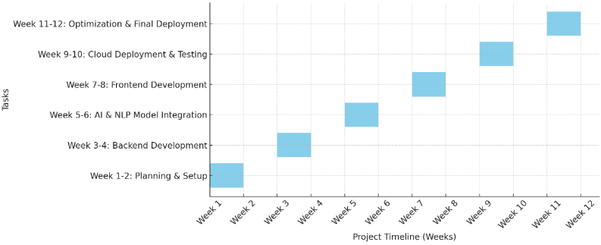
Timeline of the Project

Slide 11
Expected Outcomes
Improved Accessibility: Users from different linguistic backgrounds will have access to crucial resource materials in their native languages.
Enhanced Learning and Communication: The software will facilitate education and knowledge sharing, particularly for students and researchers.
Higher Translation Accuracy: Leveraging AI-driven models will improve the quality and contextual understanding of translations.
Support for Multiple Indian Languages: The software will cater to a wide range of Indian languages, promoting linguistic inclusivity.
Increased Efficiency in Translation Workflows: Automated translation will reduce time and effort compared to manual translation.
Scalability and Adaptability: The system can evolve with new language models, improving over time based on user feedback and advancements in AI.

Slide 12
Conclusion
The development of software for translating resource materials and other texts from English to various Indian languages is a crucial step toward enhancing accessibility, inclusivity, and knowledge dissemination. By leveraging advanced AI, machine learning, and natural language processing techniques, this software can bridge linguistic gaps and enable seamless communication across diverse linguistic communities. Ensuring high accuracy, contextual relevance, and ease of use will be essential in making the software a valuable tool for education, business, governance, and more.

Slide 13
Github Link
The Github link provided should have public access permission.
Github Link
https://github.com/jaideep8341/BhashaBridge

Slide 14
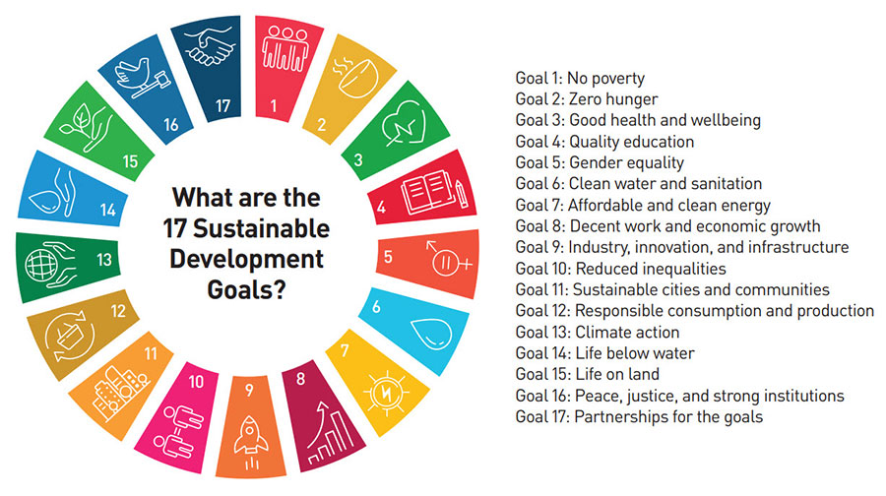
Project work mapping with SDG
Our project aims to map with Goal 3,Goal 4, Goal 8, Goal 9 and Goal 16 of Sustainable Development Goals

Slide 15
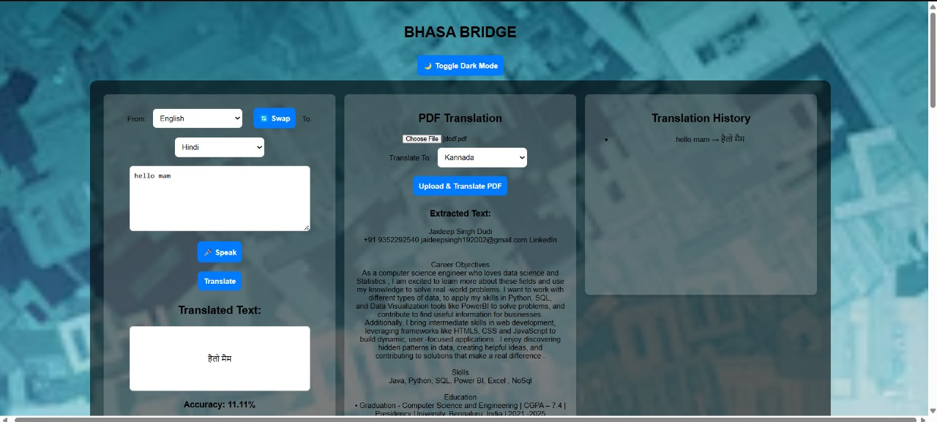
Project Work Completed till now

Slide 16
References
[1] Sen, O., Fuad, M., Islam, M. N., Rabbi, J., Masud, M., Hasan, M. K., Awal, M. A., Fime, A. A., Fuad, M. T. H., Sikder, D., & Iftee, M. a. R. (2022). Bangla Natural Language Processing: A Comprehensive analysis of Classical, Machine Learning, and Deep Learning-Based methods. IEEE Access, 10, 38999–39044. https://doi.org/10.1109/access.2022.3165563
[2]B. K. Yazar, D. Ö. Şahın, and E. Kiliç, “Low-Resource Neural Machine Translation: A Systematic Literature review,” IEEE Access, vol. 11, pp. 131775–131813, Jan. 2023, doi: 10.1109/access.2023.3336019
[3]Sethi, N., Dev, A., Bansal, P., Sharma, D. K., & Gupta, D. (2023). Enhancing Low-Resource Sanskrit-Hindi Translation through Deep Learning with Ayurvedic Text. ACM Transactions on Asian and Low-Resource Language Information Processing. https://doi.org/10.1145/3637439
[4] Xin Li; Shuai Gao “Construction of Foreign Language Translation Recognition System Model Based on Artificial Intelligence Algorithms. https://ieeexplore.ieee.org/abstract/document/10548204/authors#authors
[5] Dey, S., Sahidullah, M., & Saha, G. (2022b). An Overview of Indian Spoken Language Recognition from Machine Learning Perspective. ACM Transactions on Asian and Low-Resource Language Information Processing, 21(6), 1–45. https://doi.org/10.1145/3523179
[6] Abdul Ghafoor; Ali Shariq Imran; Sher Muhammad Daudpota; Zenun Kastrati; Abdullah; Rakhi Batra.The Impact of Translating Resource-Rich Datasets to Low-Resource Languages Through Multi-Lingual Text Processing. https://ieeexplore.ieee.org/abstract/document/9529190
[7] A. Stolcke; Barry Chen; H. Franco; Venkata Ramana Rao Gadde; M. Graciarena; Mei-Yuh Hwang Recent innovations in speech-to-text transcription at SRI-ICSI-UW https://ieeexplore.ieee.org/abstract/document/1677992
[8] Jiajun Zhang and Chengqing Zong “Deep Neural Networks in Machine Translation: An Overview https://nlpr.ia.ac.cn/cip/ZongPublications/2015/IEEE-Zhang-8-5.pdf
[9] R. Jensen; Q. Shen Semantics-preserving dimensionality reduction: rough and fuzzy-rough-based approaches. https://ieeexplore.ieee.org/abstract/document/1350758
[10] Mai Miyabe; Takashi Yoshino Evaluation of the Validity of Back-Translation as a Method of Assessing the Accuracy of Machine Translation. https://ieeexplore.ieee.org/abstract/document/7433246

Slide 17
Thank You

